Slide 1
Semantic maps: Do they reveal a universal underlying conceptual space?
Laura A. Janda
University of Tromsø

Slide 2
Main idea
We don’t know whether all languages are based on the “same” parameters
  We can’t build up a theory based on such an assumption
Semantic maps are an example of a discrete type of model, and it is possible that they conflate data that is not compatible

Slide 3
Overview
Polyfunctional grams. How can they be compared across various languages?
What is a semantic map? – Examples
DISCRETE vs. CONTINUOUS (Langacker 2006) and what this distinction means for semantic maps
Linguistic differences that cannot be accommodated in semantic maps
Conclusions: What does it mean to make linguistic comparisons?

Slide 4
Polyfunctional grams
All languages have such units
  Adpositions, inflectional and derivational morphemes, etc.
These units represent linguistic categories
  Tense, aspect, case
The categories reflect the way that people understand experiences such as physical location, time, and relationships between things

Slide 5
Polyfunctional grams
How can such units be described?
  Cognitive linguists use
    Schemas
    Prototypes
    Radial categories

Slide 6
Polyfunctional grams
An example:
  The genitive case in Slavic
    Schema: Something (trajectory) that moves or is located near something else (landmark)
    Prototypes: ‘source’, ‘goal’, ‘reference’, ‘whole’
    Radial category (with metaphorical extensions)

Slide 7
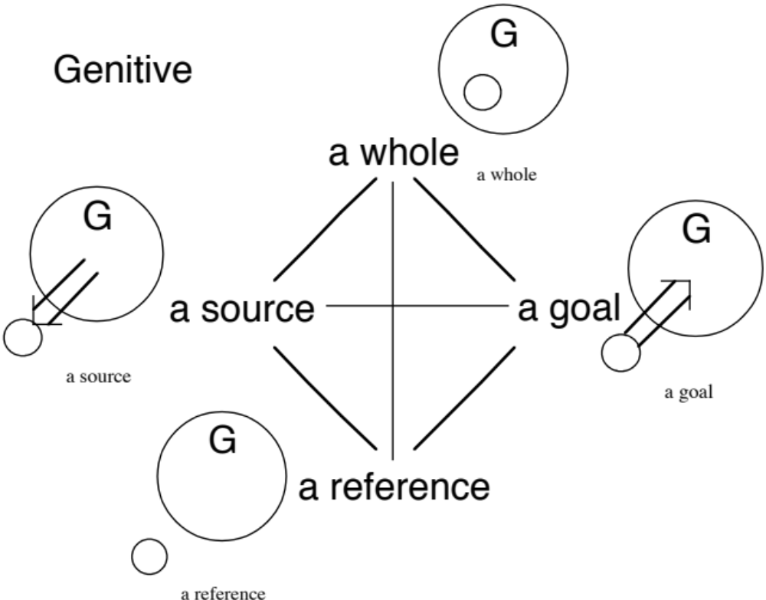

Slide 8
Polyfunctional grams
They are more complicated than one might think
  There is no one-to-one correspondence between such units and the concepts that they represent
  These units often overlap with each other
  These units can be used in various combinations
See Polish examples 1 and 2

Slide 9
Polyfunctional grams
It just gets worse when one tries to compare such units across several languages
  See examples 3 and 4
    Polish, Czech, and Russian inherited the “same” preposition and case systems
What happens when we have dissimilar, unrelated languages? Semantic maps are designed to compare large numbers of languages

Slide 10
What is a semantic map?
The most prominent theorists are
  Croft
    (2001, 2003, Croft and Poole 2008)
  Haspelmath
    (1997a, 1997b, 2003)
Others who have made significant contributions
  Anderson (1982), Clancy (2006), Kemmer (1993), van der Auwera & Plungjan (1998), van der Auwera, Dobrushina & Goussev (2004), van der Auwera & Malchukov (in press), van der Auwera & Temurcu (in press)

Slide 11
What is a semantic map?
Terminology
  Conceptual space
    All possible distinctions that a human being can perceive
    The backdrop (grid) for a semantic map
  Semantic map
    The distribution of actual distinctions made by one or a number of languages across the parameters of conceptual space

Slide 12
What is a semantic map?
Research proceeds from individual languageas to semantic maps to conceptual space
Semantic maps claim that it is possible to find
  Parameters of a universal conceptual space (what kinds of distinctions human beings can both perceive and code in language)
  Implicational universals (which functions can co-occur in grams)
  Grammaticalization paths (diachronic directions for grammaticalization)

Slide 13
Are there limitations to semantic maps as a linguistic model?
When semantic maps compare several languages, the model is making an important assumption:
  All languages are based on same parameters, merely choosing various subsets of those parameters for grammaticalization
Is it really possible to discover the parameters of human conceptualization by using semantic maps?
First we need to work through an example…

Slide 14
Temporal locations
(Haspelmath 1997b)
hour
year
day part
season
day
month

Slide 15
English
at
hour
year
day part
season
day
month
on
in

Slide 16
Norwegian
[no preposition]
i
hour
year
om
day part
season
day
month
på

Slide 17
Polish
locative
o
hour
year
instrumental
day part
season
accusative
day
month
[no preposition]
w
genitive

Slide 18
The semantic map for temporal location
It works – We do find a typological pattern here
  All languages use only contiguous portions of the map
  In contiguous portions of the map we find
    longer time periods vs. shorter time periods
    day part connected to day vs. season connected to year
But these are not “deep” conclusions

Slide 19
DISCRETE vs. CONTINUOUS
Langacker (2006)
  All models are metaphorical, and all metaphors are potentially misleading
  All metaphors emphasize some factors and suppress others
  When a model is too discrete or too continuous, it suppresses information
  Linguistic models tend to be too discrete
  Even a misleading model can lead to good results if the person using it takes into consideration its limitations

Slide 20

Advantages of discrete models
One can find “things” and “groups” in a continuous reality (galaxies, archipelagoes, villages, cf. Langacker 2006)
One can see how how individual grams overlap in their functions in a given domain
One can find typological patterns across languages
One can visualize messy empirical data as coherent wholes (more organization than a list and more details than an abstract general meaning, cf. Haspelmath 2003)

Slide 21

Limitations of discrete models
Semantic maps see only discrete points and ignore the continuous zones between them
This effect is amplified when one makes comparisons across languages
A cross-linguistic semantic map is two orders of magnitude more discrete than a radial category, for it ignores the continuous zones both at the level of individual languages and across languages

Slide 22
Other limitations of discrete models
When we say in November (Eng), i november (Norw) and w listopadzie (Pol), do in, i and w have “the same meaning”?
Even when in, i and w are used in “the same meaning”, they have different things in their semantic baggage (different prototypes and metaphorical extensions)
A semantic map shows only the “distances” between units – it doesn’t tell us anything about their meanings (Langacker, pc 2006)

Slide 23
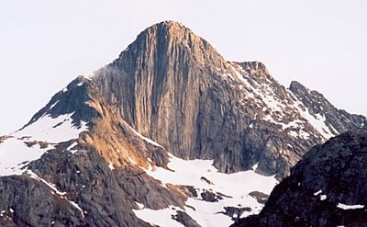
Langacker’s alternative: a mountain range
discrete points
continuous fields

Slide 24
Differences that cannot be accommodated in semantic maps
Up until this point we have only talked about quantitative differences between models (discrete vs. continuous)
We just assumed that the things that were being compared were indeed comparable…

Slide 25
Qualitative differences
Different parameters
  one language uses one set of parameters and another language uses an entirely different set of parameters for the “same” domain
Different means
  one language has grammaticalized a distinction that another language represents only optionally in the lexicon
Different metaphors
  In different languages the “same” grammatical distinction is motivated by different metaphors

Slide 26


Different parameters
Gender is very different in different languages
  Finnish has no grammatical gender distinctions, but gender is obligatorily marked on nouns, adjectives, pronouns, and verbs in Slavic languages like Polish
Location can be expressed in a variety of different ways
  Tzeltal uses cardinal directions even for locating small items, whereas other languages use deictic terms such as right vs. left, in front of vs. behind

Slide 27


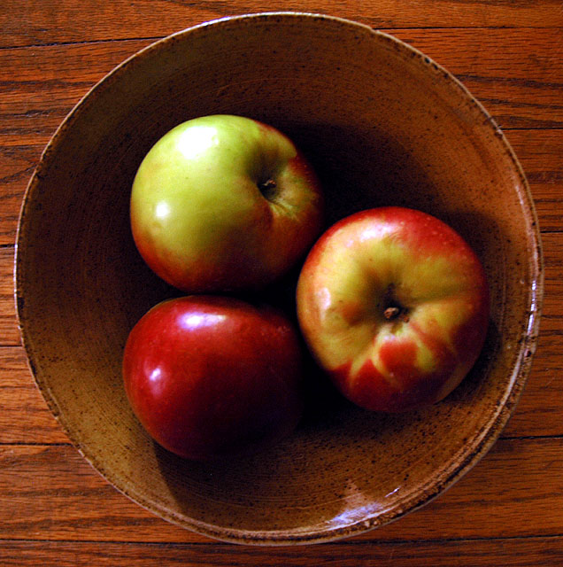


A: The apples are inside-bowl
B: The apples are loose fitting-bowl
Do all of these distinctions come
from only one conceptual space?
C: The apples are concave valley that faces me-bowl
D: The apples are stomach-bowl

Slide 28
Semantic maps of expressions for spatial location
Levinson et al. (2003): 71 expressions for spatial location from 9 languages
  Goal: to find out which expressions cluster together (rejecting the notion that these clusters represent innate universal categories)
Croft & Poole (2008): used Levinson’s data and applied more sophisticated mathematical analysis (Multi Dimensional Scaling)
  Goal: to find universal categories

Slide 29

Other questions
Levinson et al. (2003) used data from 9 languages, but there are perhaps as many as 7000 languages in the world
  Do we want to base a theory on only 0.13% of the relevant data?
Levinson et al. (2003) researched 71 expressions for spatial location
  Do we know that these 71 spatial locations are precisely the ones that represent all the differences that a human being can perceive and encode in language?

Slide 30
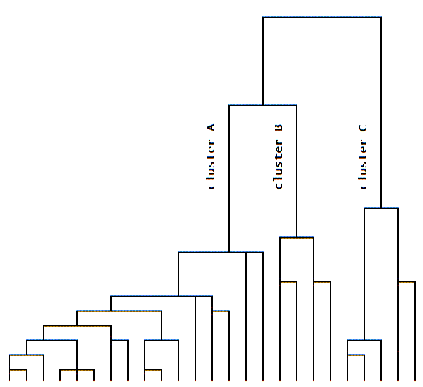
Different means
A concept can be expressed by a grammatical category in one language, but be expressed only lexically in another language
  Evidential verb paradigms in Macedonian and Albanian vs. angivelig (Norw), allegedly (Eng), rzekomo (Pol)
Two (or more) concepts can have different status in different languages
  verb-framed vs. satellite-framed

Slide 31
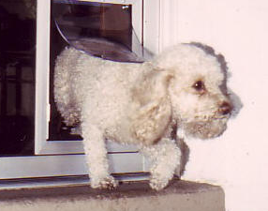
El perro entró corriendo
Hunden løp inn
On a semantic map these
differences disappear

Slide 32
Different metaphors
Human beings cannot perceive time directly, and it seems that all languages use the TIME IS SPACE metaphor
  But different languages use different versions of this metaphor
    Expressions for before vs. after
    Aspect in Russian

Slide 33
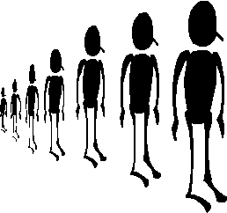
behind
(me)
in front
Haspelmath (1997b: 56-57)
  Many languages use IN FRONT to express ‘before’
    German vor, Latin ante, Polish przed, Albanian para
  Fewer languages use BEHIND to express ‘after’
    Latin post, Albanian pas

Slide 34
Aspect in Russian: three (pairs of) metaphors
Discrete solid object vs. Fluid substance => Perfective vs. Imperfective
Travel vs. Motion => Completable vs. Non-completable
Granular vs. Continuous => Singularizable vs. Non-singularizable

Slide 35
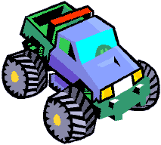

Discrete solid object vs. Fluid substance => Perfective vs. Imperfective
Discrete solid
object
=> Perfective
Fluid substance
=> Imperfective
vs.
Ja napisal roman
‘I have written a novel’
The event has a shape,
clear boundaries, etc.
Ona gotovilas’ k èksamenam
‘She studied for the exams’
The event has no shape, clear boundaries, etc.

Slide 36
Travel vs. Motion =>
Completable vs. Non-completable
Professor rabotaet
v universitete
‘The professor is working
at the university’
The verb can have a
Complex Act Perfective:
porabotat’ ‘work for a while
(without a result)’
Pisatel’ pišet knigu
‘The author is writing a book’
The verb can have a
Natural Perfective:
napisat’ ‘write
(until a result is achieved)’

Slide 37
Granular vs. Continuous =>
Singularizable vs. Non-singularizable
Mal’čik čixal
‘The boy sneezed/was
sneezing’
The verb can have a
Single Act Perfective:
čixnut’ ‘sneeze (once)’
Mal’čik igral vo dvore
‘The boy played outside’

Slide 38
Metaphorical differences can’t be accommodated in semantic maps
The metaphorical system for aspect in Russian is very complex
  Other languages probably use other metaphors for aspect
  A semantic map has to ignore metaphorical differences
  How can one make comparisons across a number of different metaphorical systems?

Slide 39
Semantic maps of aspectual expressions
Dahl (1985): expressions for 250 types of events from 64 languages
  Goal: to find out which expressions cluster together (rejecting the notion that these groups represent universal categories)
Croft & Poole (2008): used Dahl’s data and applied more sophisticated mathematical analysis (Multi Dimensional Scaling)
  Goal: to find universal categories

Slide 40
Other questions
Dahl (1985) used data from 64 languages, but there are perhaps as many as 7000 languages in the world
  Do we want to base a theory on only 0.9% of the relevant data?
Dahl (1985) researched expressions for 250 types of events
  Do we know that these 250 types of events are precisely the ones that represent all the differences that a human being can perceive and encode in language?

Slide 41
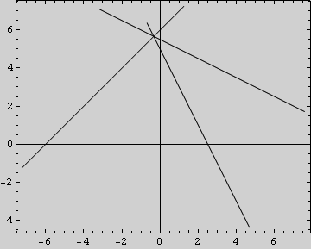
Conclusions
Some theorists (Croft, Poole, Haspelmath) claim that
  a) A single universal conceptual space exists
  b) The grammar of each language is the sum of the “lines” drawn by that language across this single shared space
Is this what we think
a grammar looks like?

Slide 42
What does it mean to make linguistic comparisons?
We don’t know whether a single universal conceptual space exists
It is possible that different languages “inhabit” different conceptual spaces
A semantic map necessarily ignores the meanings that motivate points of usage and the continuous fields between them
We don’t know whether the things that are compared on a semantic map can be compared at all

Slide 43

Summary
Semantic maps can
  Help us to visualize complex data
  Help us to find a pattern across a number of languages
But we must be cautious and remember that
  We still know very little about conceptual space and whether it is universal or not
  A semantic map is a relatively discrete model and it may conflate data that is incommensurate

Slide 44
Many thanks to:
Steven Clancy, William Croft, Östen Dahl, Martin Haspelmath, Ronald Langacker, Johan van der Auwera, who shared their ideas with me

